Slide 1
Ch12 & 13 Review: Comparing Two Population Mean and Proportions

Slide 2
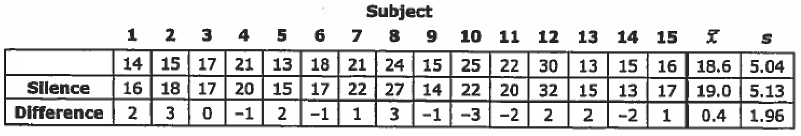
Does listening to music increase the speed at which people complete routine tasks? 15 volunteers are asked to sort 100 red and white beads into two piles according to color, once while listening to music and the other time in silence. The order of each is determined randomly by flipping a coin. The data below shows the time (seconds).
MUSIC
Which of the following is the correct test?
An one sample T-Test d) A two sample Z -test
An one sample Z-test e) A matched Pair test
A two sample T-test

Slide 3
From the previous problem, if we wish to perform a hypothesis test on whether if listening to music would have an affect on the time required to separate the beads, which of the following is the appropriate test statistics?
MUSIC

Slide 4
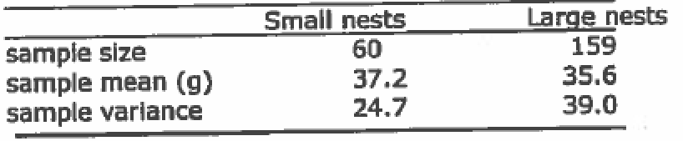

A researcher wants to see if birds that build larger nests lay larger eggs. She selects two random samples of nests; one of small nests and the other of large nests. She weighs one egg from each nest. The data is summarized below :
Which of the following will give the 95% confidence interval for the difference between the average mass of eggs in small and large nests?

Slide 5
A SRS of 100 managers showed that 64 owned an iphone. An SRS of 100 students showed that 80 lower level employees owned an iphone. Let p1 be the proportion of managers that owned an iphone and p2 be the proportion of all lower level employees that owned an iphone. What is a 95% confidence interval for the difference between p1 and p2?

Slide 6
A grocery store receives it’s apples from two suppliers. Supplier A ships 400 boxes of apples with 20 defective. Supplier B supplies 100 boxes of apples with 10 defective. Let p1 and p2 be the proportions of defective boxes from supplier A and B respectively. Which of the following is a 95% confidence interval for p1 – p2?

Slide 7
In a SRS of 1,250 adults, 450 said that they would cut their driving by 10% if this significantly helped the environment. Find a 95% confidence interval estimate of the proportion of adult drivers who are willing to cut their driving by 10% to help the environment:

Slide 8
Should their be more restrictions on firearms? In an early 2000 survey, 255 out of 1020 residence supported more restrictions. In 2020, 352 out of 1,100 supposed more restrictions. Establish a 90% confidence interval estimate of the difference between proportions of residence that support more restrictions on firearms.

Slide 9
230 students were taught in a traditional math class, with a class average score of 76.5% and std dev of 7.5. 185 students were taught in an innovative math class, with a class average score of 78.8% and std dev of 5.6. Is there sufficient evidence in a difference of test scores? What is the test statistic (Z value or T-value) for this test?

Slide 10
Before a televised debate, in a poll of 800 registered voters, 560 said they would support the new candidate. After the debates, a poll of 600 voters, 450 said they would support the new candidate. Is there sufficient evidence that the candidates popularity increased? What is the test statistics? (Z value)

Slide 11
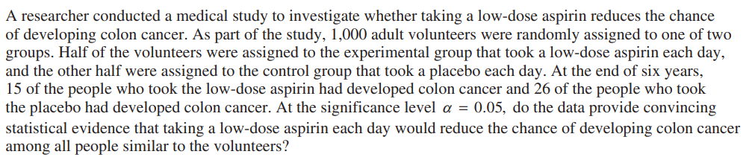

Slide 12

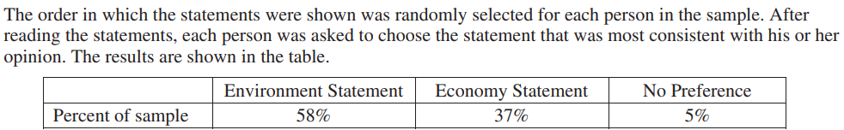
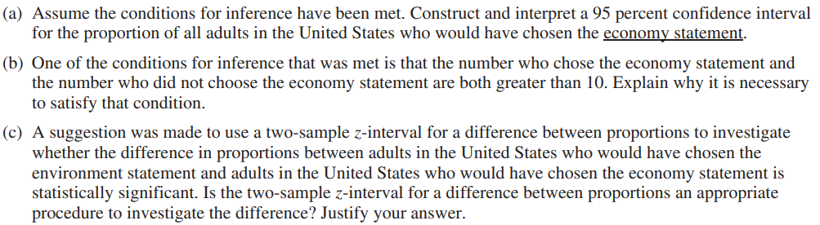

Slide 13
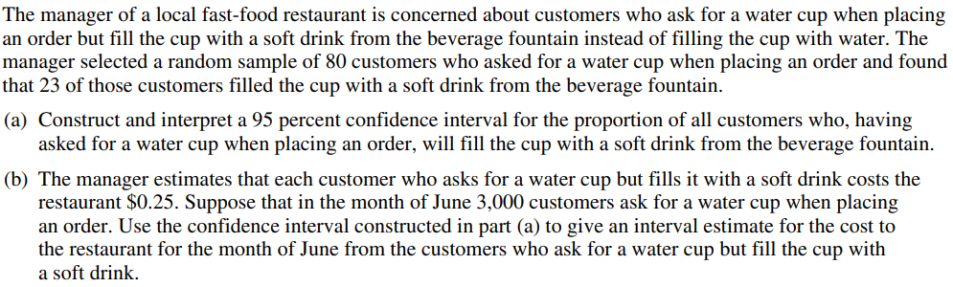

Slide 14
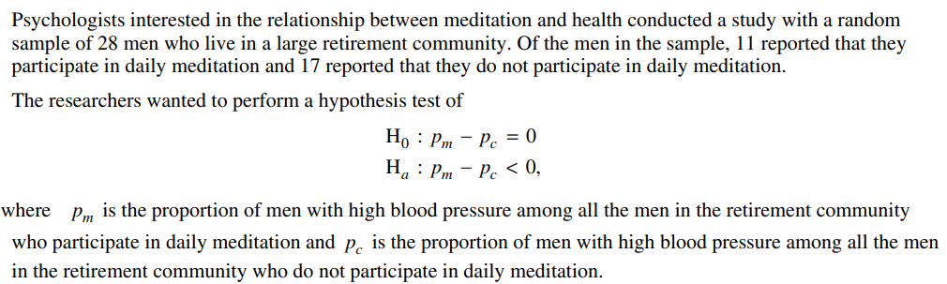

Slide 15
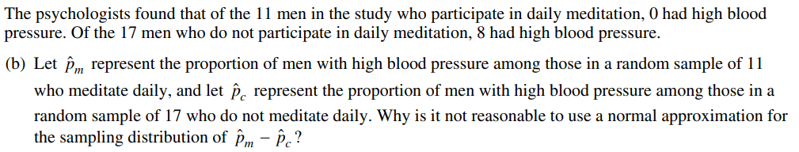

Slide 16
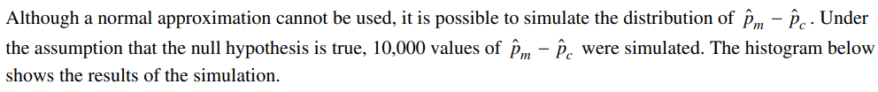
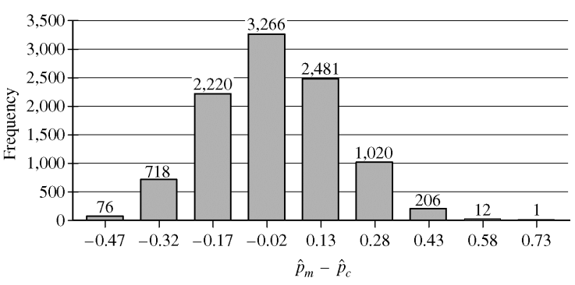

Slide 17
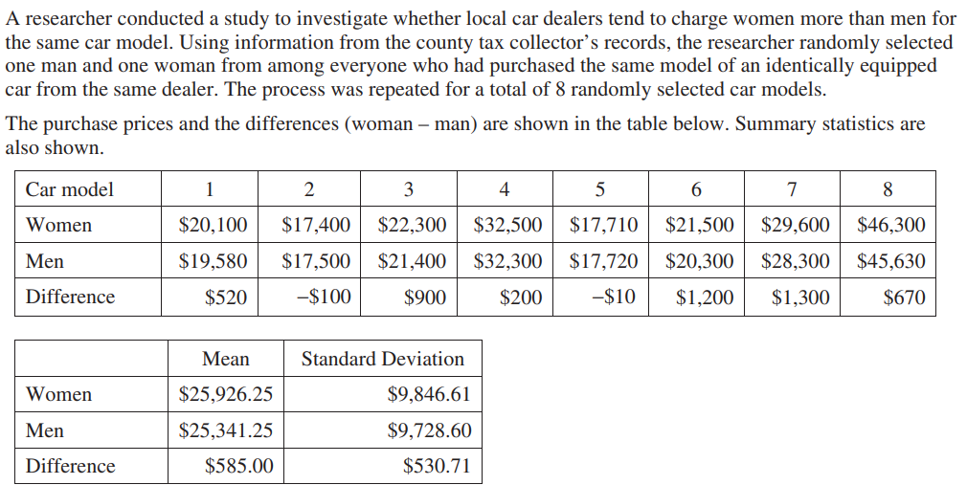
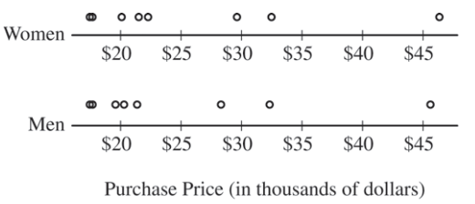

Slide 18
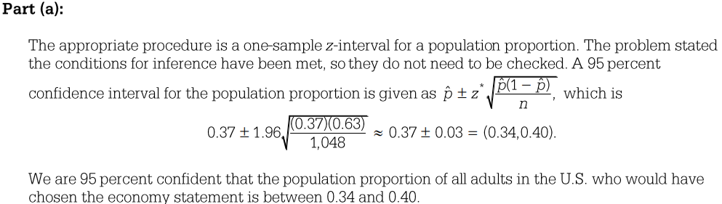
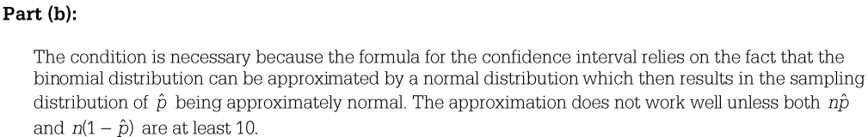
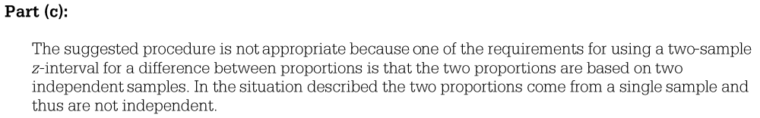

Slide 19
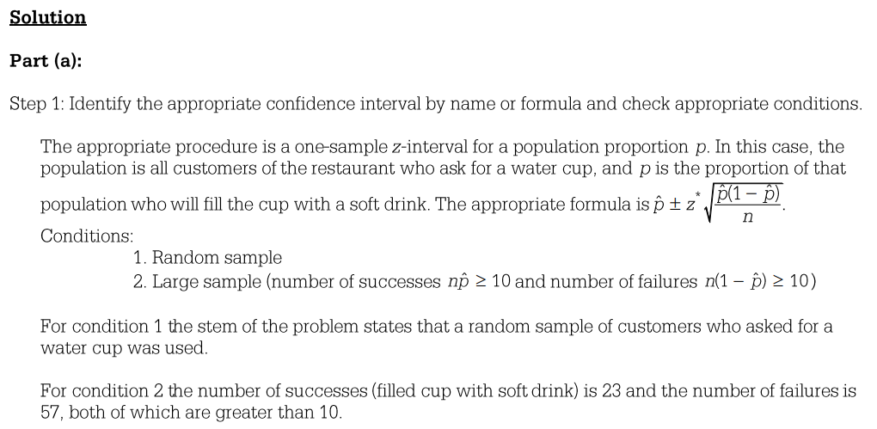

Slide 20
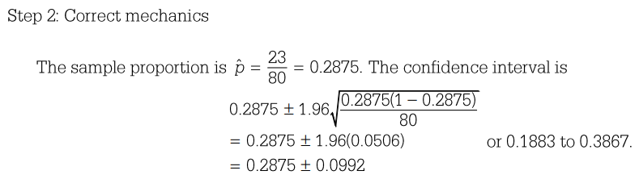
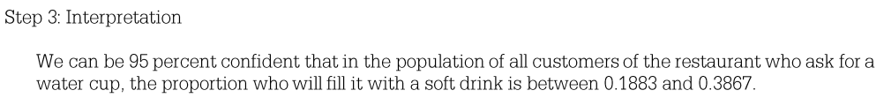
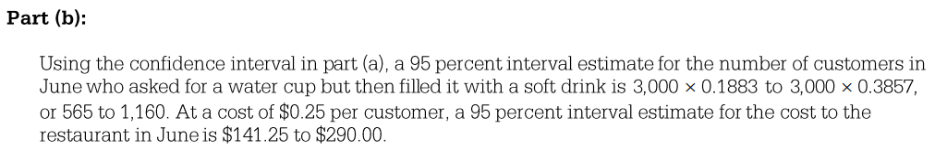

Slide 21
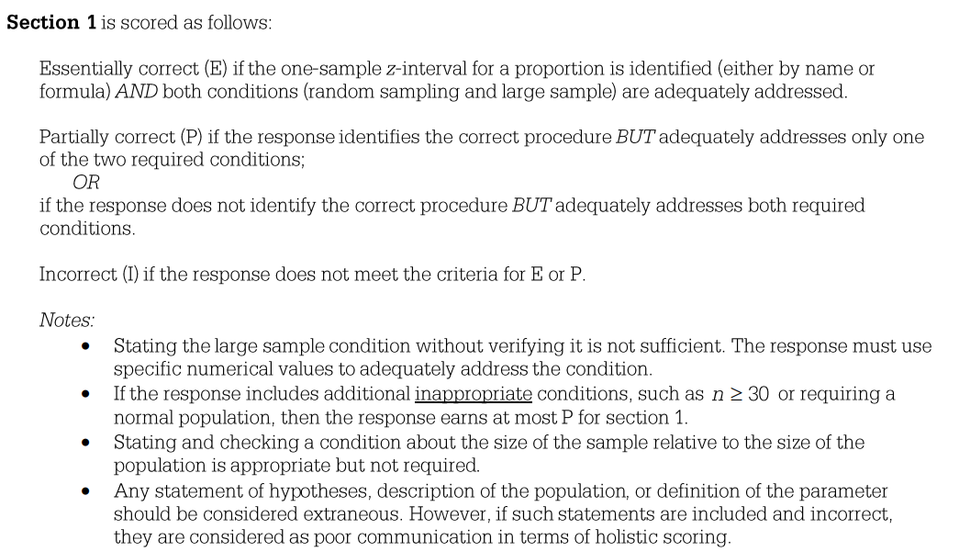

Slide 22
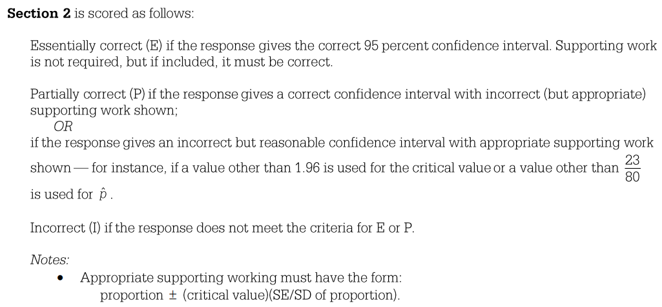

Slide 23
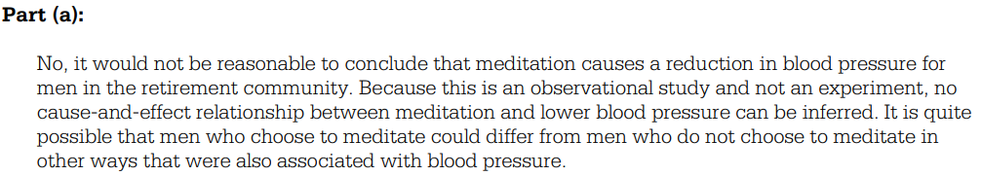
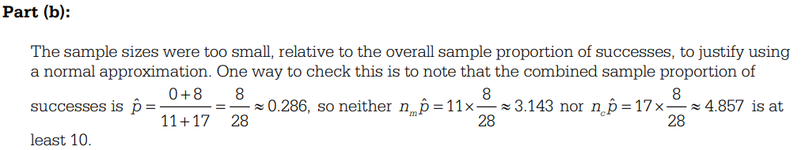

Slide 24
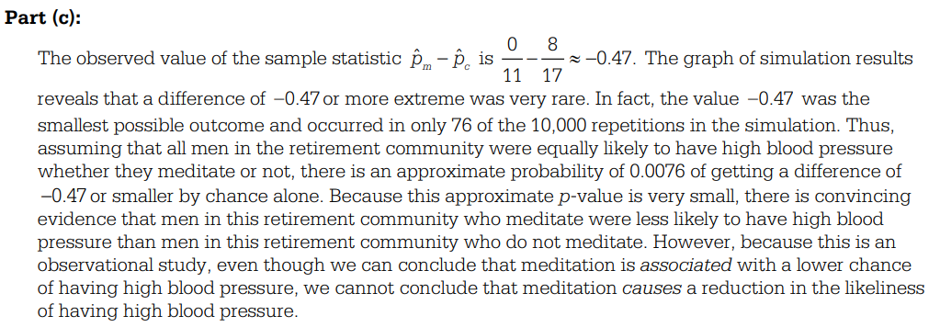

Slide 25
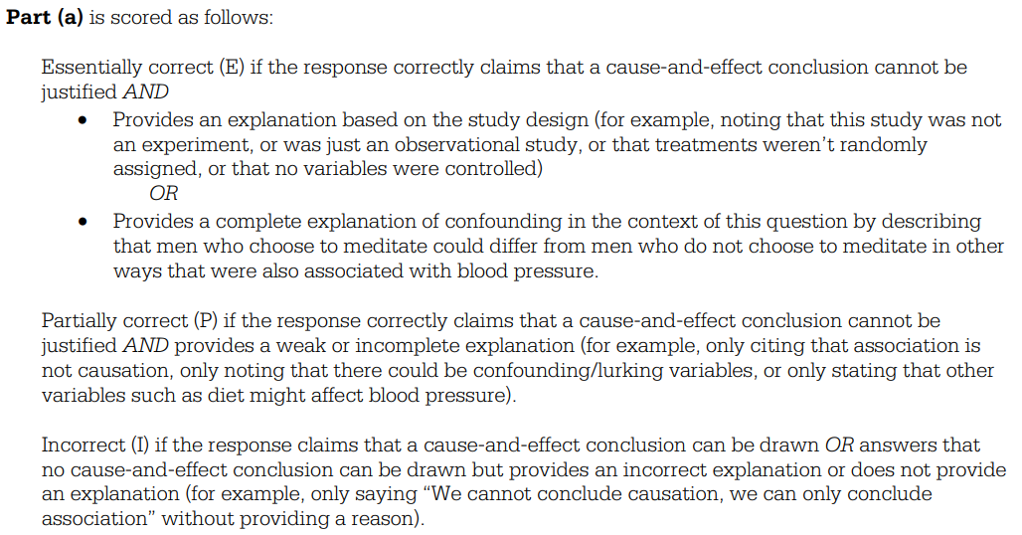

Slide 26
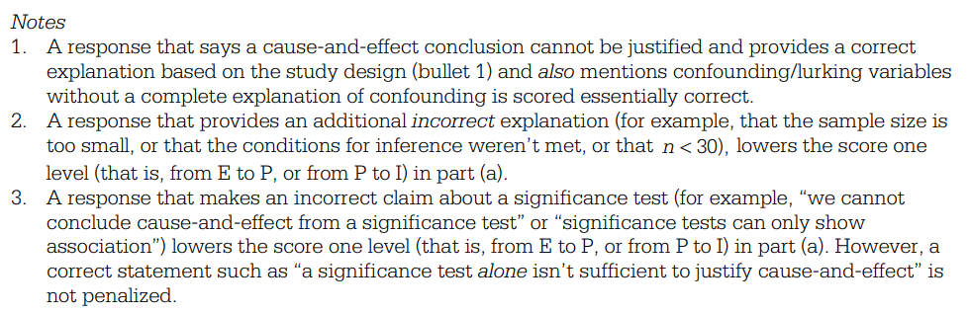

Slide 27
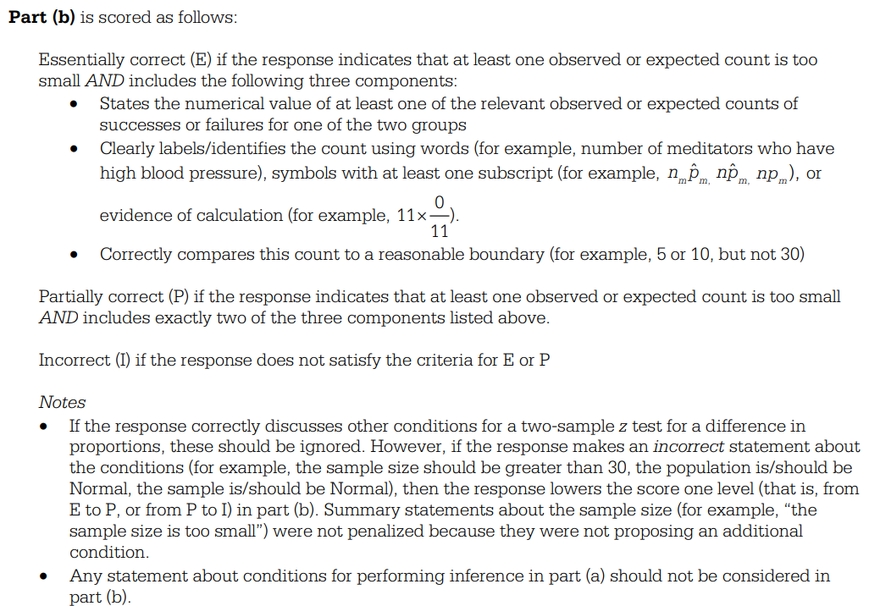

Slide 28
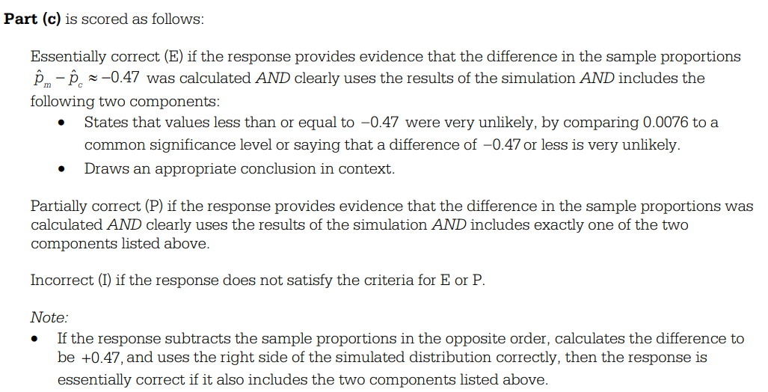

Slide 29
